Slide 1

Eli Lilly and Company
Scenario evaluation tool
SFSDS - core user training
May 2nd, 2006
This presentation is solely for the use of client personnel. No part of it may be circulated, quoted or reproduced for distribution outside of the client organization without prior written approval of ZS Associates.
ZS Associates
212.808.3300 Tel
www.zsassociates.com

Slide 2
Agenda
Overview 10:00 to 10:20am
  Marketing planning approach overview
  Scenario evaluation tool (SET) overview
    Role and primary functionality
    Key inputs and outputs
    Software structure
  Project flow
Mock Project1 – Session1 10:20 to 12:00am
  Tool Setup
  KPO Spend based scenario creation
Mock Project1 – Session2 12:00 to 1:00pm
  Alternate Scenarios Evaluation
  Brand Team Meeting Preparation

Slide 3
Lilly US is developing a standard marketing planning approach¹ to help its brands effectively allocate marketing investments
Overview
Lilly’s marketing planning approach consists of frameworks, analytics, and tools to decompose brand marketing strategy, link marketing investments to strategy elements, and optimize investments to achieve brand goals
Lilly SFSDS has developed the impact analytics to help each brand estimate the likely revenue and contribution impact for alternate channel investment scenarios across key player segments
The analytical evaluation of the scenarios currently requires considerable interaction with the brands
  Some of the steps in the analytical process take several days to complete as there are multiple iterations through currently manual processes. These can be performed faster with the help of a user friendly automated tool
  Automating these steps will increase focus on value-added activities such as results interpretation and recommendation synthesis, enabling a better leveraged planning process
as as part of PROJECT IMPACT

Slide 4
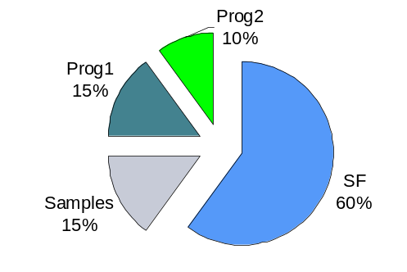
The marketing planning process spans strategy development, design & assessment of channel tactics and ongoing refinement
Overview
2
Map tactics to strategic drivers
SF
1
DTP
Model long-term impact of
combined marketing tactics
Identify core strategic drivers or
key player objectives
3
MD Visit
(Growth)
Smp
M&E
Treatment
(Share)
Share Impact
X
Brand
Request
Fulfillment
Persistence
SF
PROG1
Frequency
Compare projected
4
5
Simulate and optimize
marketing spend across channels
 | Baseline | Planed Δ | Actual Δ
Awareness | 60% | 15% | 10%
…
Share | 35% | 5% | 5%
LOT | 60 days | 10 days | 12 days
Sales | $550 MM | $100 MM | $120 MM
The Scenario Evaluation Tool’s (SET) role is to enhance SFSDS efficiency in the modeling parameters, forecasts and comparisons

Slide 5
The SET tool facilitates trade-off decisions through a scenario-based approach focusing on health care provider channels for a brand
Overview
The SET tool enables users to:
Manage a library of scenarios iteratively created during the course of the trade-off decision making process
Input and store key parameters for each scenario
  E.g. segments, channels, response parameters, activity costs, product price, margin, etc.
Specify KPO (key player objectives) and simulate brand team’s related baseline channel spend scenario
Simulate and display key outputs for each scenario
  E.g. Activity (reach, frequency) and financials (spend, revenue, contribution)
Create and optimize scenarios derived from the baseline with minimal additional user inputs
  Fixed channel investment – optimize allocation across key player (KP) segments
  Fixed key player segment investment – optimize allocation across channel
  Fixed brand investment – optimize allocation across channel and key player segment
  Unconstrained – optimize overall spend and allocation across KP segment and channel
Incorporate constraints to model real world issues (e.g. physician access , quarterly budgets, etc.) and iteratively assess alternate scenarios
Compare results across multiple scenarios; Import and export scenarios across users
HCP = health care provider

Slide 6
SET is structured around making KPO spending decisions
Overview
The marketing plan is based on Key Player Objectives (KPOs)
The KPOs designate marketing spends to different customers
  The customers are first segmented into Groups
    E.g. PCPs, Pediatricians, Psychiatrists, …
  The Groups may be further divided into Segments
    E.g. PCP – high decile – high share, PCP – low decile – high share, …
Similarly the marketing spends are segmented into Channel Groups
  The channels are further divided into Channels
    E.g. Details, Samples, DTP1, DTP2, …
  This allows the analyst to report against groups of channels

Slide 7
Users input response parameters, conversion factors, and constraints along the key marketing dimensions
Overview
Marketing mix dimensions
  Groups, segments
  Channels, channel groups
  KPOS
  Time periods
Inputs
Outputs
Response parameters
  Response functions
  Interaction terms
  Spread factors and lag terms
Rx and financial conversion factors
  Market NRx/MD
  Brand NRx/MD
  Refill Ratio
  Activity costs
  Product Price
  Margin
Constraints
  Reach % by segment
  KPO spend
  Activity/spend bounds
  Dynamic constraints
Activity outputs
  Frequency
  Reached MDs
  Total activity
Spend outputs
  Spend
  Mix percentage
Rx and revenue outputs
  1 year NRx
  1 year TRx
  1 year revenue
  3 year NRx
  3 year TRx
  3 year discounted revenue
  1 year contribution
  3 year discounted contribution
SET estimates activity, spend, Rx, and revenue outputs based on these inputs

Slide 8
User interaction with SET can be visualized as a series of phases leading up to a brand team session
Overview
1. Problem Structure Definition
2. KPO Spend-based Scenarios Evaluation
3. Alternate-Possibility Scenario Evaluation
4. Brand Team Meeting Summary Creation
Prepare data
Setup the dimension structure
Enter the estimated brand team KPO baseline spend
Model the long term impact of sales
Estimate the revenue derivation parameters
Define all logistic constraints
Validate entries
Optimize and review Baseline scenario outputs
Refine inputs as necessary
Define alternate KPO spend-base scenarios
Batch validate and optimize scenarios
Review and compare all KPO spend-based scenarios
Specify dynamic constraints (e.g. mix constraints, samples per detail constraint)
Create any incremental spend bound scenarios
Create scenario summaries
Review inputs, key scenario outputs
Address high level revenue implications
Refine and Detailed tabular outputs
Adjustments to parameters
This training session is intended to familiarize users with SET functionality through a mock project structured along these phases

Slide 9
The SET Tool formulates a marketing mix model based on user inputs, optimizes it using LINGO, and displays the outputs through its interface
Overview
SET
Marketing Mix Model
Formulation
file
SET
LINGO
Modeling Tool
Inputs interface
Modeling Tool post optimization
Frequency outputs
Modeling Tool
results interface
Optimization
engine
LINGO
Data file containing inputs
Excel
The user provides key inputs and defines model constraints through the SET input interface
The tool translates the inputs into a data file and a mathematical model which feed it to LINGO
LINGO optimizes the model using a non-linear optimization scheme and provides frequency outputs to SET
SET translates frequency results into a complete set of outputs for the user to view along different dimensions
Primary SET users are SFSDS analysts responsible for populating inputs, reviewing scenario analysis, and sharing results with the brand team

Slide 10
Agenda
Overview 10:00 to 10:20am
  Marketing planning approach overview
  Scenario evaluation tool (SET) overview
    Role and primary functionality
    Key inputs and outputs
    Software structure
  Project flow
Mock Project1 – Session1 10:20 to 12:00am
  Tool Setup
  KPO Spend based scenario creation
Mock Project1 – Session2 12:00 to 1:00pm
  Alternate Scenarios Evaluation
  Brand Team Meeting Preparation

Slide 11
Problem Structure Definition
1. Problem Structure Definition
2. KPO Spend-based Scenarios Evaluation
3. Alternate-Possibility Scenario Evaluation
4. Brand Team Summary Creation

Slide 12
Mock project description ….
Setup
Input dimensions | Levels
Groups | 3 groups – PCP, PED, and IM
Segments | 3 segments per group: 10_[Group]_seg[ ]
Channels | 5 Channels: Details, Samples, Prog1, Prog 2, DTP1
Channel groups | 4 Channel groups : Sales Force, Samples, Field Customer Programs, Brand Customer Programs
KPO’s | 6 KPO’s with brand specified spend
Input parameters | Description or values
Response models | Response models with power terms, Non-linear 1/3rd power for details, samples, audio, and speaker channels; linear [power term for direct mail and dtp programs
Lag terms | Higher lag for higher decile and higher product share segments
Activity costs | Audio-$155, Detail-$64, DTP1-$300, DTP2-$45, Mail-$3, Samples-$3.1, Speaker-$235
Price per TRx | $110
Margin | 100%

Slide 13
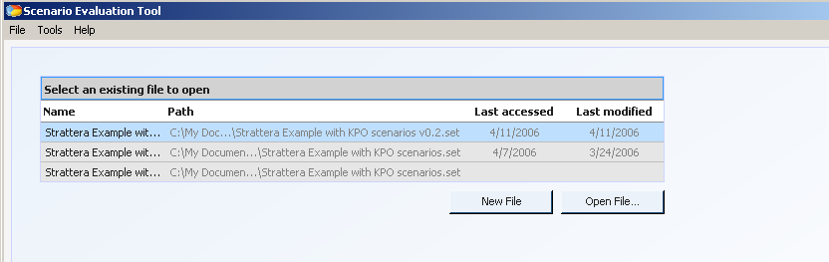
Some logistics before we start …
Setup
Install SET.exe into a suitable folder on your computer
Copy training material into a suitable folder on your computer
Launch SET.exe
Open Training_Ex.set using Open File
Note: You must first open SET.exe to open any .set files
User can either create a new .set file, or browse to open an existing .set file

Slide 14
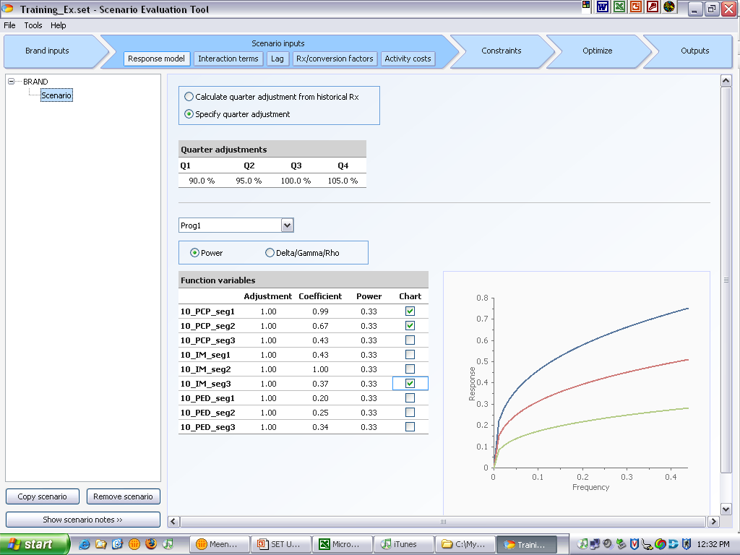
The SET application has three main aspects – the user guide at the top, the brand/scenario list on the left and the main editing/viewing frame
Setup
User guidance section
Main editor frame
Scenario/Brand Selection Section

Slide 15
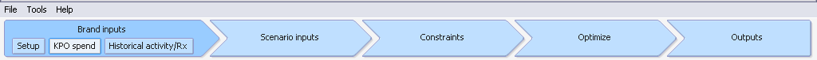
The SET tool, as well as this User Guide, is organized into 5 sections: Brand Inputs, Scenario Input, Constraints, Optimize and Outputs
Setup
Input Sections
  Brand Inputs: model parameters that do not vary by scenario (e.g., KPO spends, historical Rx activity, etc.)
  Scenario Inputs: model parameters that will vary by scenario (e.g., response curves, lag terms, activity costs, etc.)
  Constraints: limits that are placed on reach, spending levels, activity levels, etc.
Optimization Section
  Optimize: LINGO settings and functional call, QC checks, etc.
Outputs Section:
  Outputs: summary of optimal spending decisions by KPO; this section has both high-level summaries and scenario details

Slide 16
The first section of the tool supports entry of brand-based inputs that are common across all scenarios within a specific brand
Setup
View Name | Description | Metrics
Setup | Structural base of the problem | Start Year, Groups, Segments, Channels, ChannelGroup
KPO | Information related to estimated necessary spend by KPO and ChannelGroup | KPO Spend by Quarter
Historical Activity/ Rx | Data for comparison and reference OR for simulation | Historical Activity, Historical Reach, Average Quarterly NRx
Any changes in Brand Inputs will affect all scenarios within the brand

Slide 17
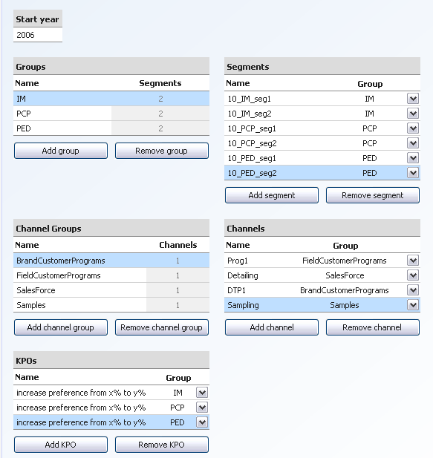
The “Setup” view supports entry of the different marketing planning dimensions – groups, segments, channel groups, channels, and KPOs
Setup
Enter the year that marketing effort will take place
Enter a unique list of Groups using the buttons
Enter a unique list of Segments using the buttons
Link each segment to a group using the dropdown-menu. This automatically update the segment counts in the group grid
Enter a unique list of ChannelGroups using the buttons
Enter a unique list of Channels using the buttons
Link each channel to a channel group using the dropdown- menu. This will automatically update the channel count
Enter a list of KPO names using the buttons
Link each KPO to a group. Each KPO must be unique by name –linked group combination
The grids can also be copied from Excel

Slide 18
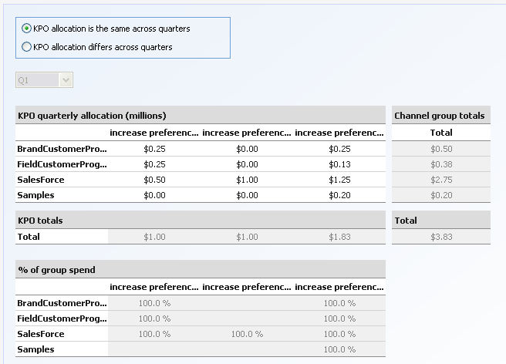
The “KPO grid” view enables users to input the baseline brand team quarterly spend inputs by channel group associated with each KPO
Setup
Choose to enter the KPO allocation as the same or different across quarters. Choosing to enter different spends per quarter will enable the quarter drop down menu.
Please note that in either case the grid should be populated with quarterly spend and NOT annual spend
The dropdown menu can be used to move between quarters.
Enter KPO allocation by quarter and ChannelGroup in millions.
Column and row totals and percent allocations will automatically update
All greyed-out data, menus, and buttons are not enabled and cannot be changed. Grey-out data serves as a reference.
The actual enforcement of these spend inputs can be selectively turned on and off within the KPO constraints view in the constraints section

Slide 19
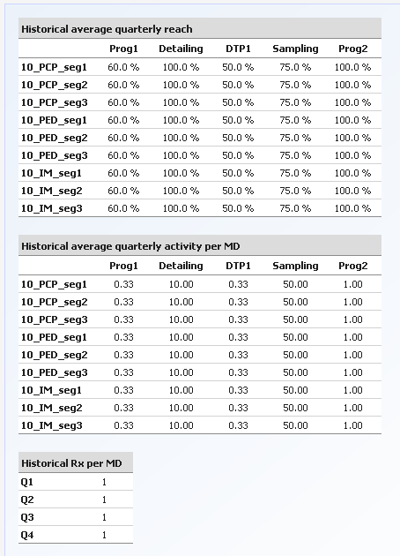
The “Historical activity/Rx” view facilitates entry of quarterly reach and activity per MD for each channel x segment
Setup
Enter the historical average quarterly reach by channel x segment in percents
Enter the historical average quarterly activity per MD by channel x segment in percents
Enter the historical Rx per MD which will be used as the NRx Adjustment Factor. These numbers can also be used to calculate the Quarterly Adjustment factor on the Response Screen
The activity inputs are required mainly for initializing optimization runs later

Slide 20
Training exercise for brand inputs
Setup
Navigate to the setup view in the brand inputs section
Change Brand name to Strattera
Add three segments and link them to the PED group
  10_PED_seg1
  10_PED_seg2
  10_PED_seg3
Enter the missing channel as DTP1 and change its channel group mapping to a Brand Customer Program
Delete the KPO “Increase Market share by 10%”
Copy and paste the Historical Activity and Frequency from Training_Ex.xls

Slide 21
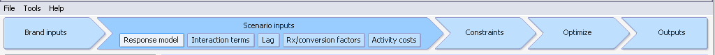
The second section of the tool supports entry of scenario inputs that create differing scenarios within a specific brand
Setup
View Name | Description | Metrics
Response | Response model formulation and definition | Quarter Adjustments, Response Model type, Response Adjustment, Model Parameters
Interaction | Interactions between marketing channels | Interaction channels, interaction model parameters (coefficient, power), split
Lag | Description of how the sales impact will be realized over time | Discount rate, spread factors, lag factors, lag adjustment factor, quarter to 3 Year multiplier
Rx/Conversion Factors | Data for calculation of response into revenue dollars | Brand NRx, Market NRx, MD Count, Refill Rate, Price per TRx, Margin
Activity Costs | Data for the calculation of marketing costs | Activity costs

Slide 22
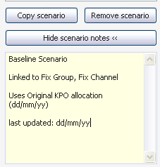
A systematic scenario naming and documentation convention is suggested to ensure future transparency
Setup
Naming Scenarios:
A naming convention to track changes made between versions, users and scenario importations.
An example method is to name each scenario as follows:
[Brand name]_[Scenario name]_[version] e.g. Strattera_Baseline_v1
Using the Notes Section:
Identify the parent scenario on which the current scenario is based
List all changes from one version to the next
Highlight the hypothesized drivers and important points
Identify any linking scenarios (scenarios in other brands or files that rely on data in the current scenario)
Document most recent date of modification/ date of creation

Slide 23
Training exercise – scenario naming and documentation
Setup
Navigate to the scenario inputs section
Change Scenario name to Strattera_Baseline
Using the Notes Section, identify the scenario and the date of creation

Slide 24
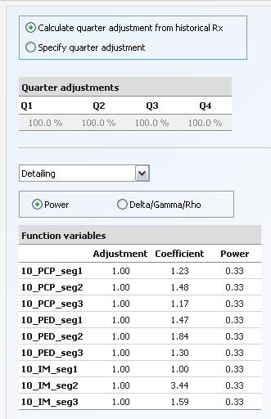
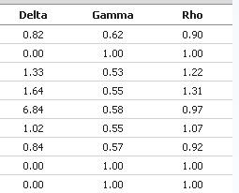
The “Response model view” supports both a power and an s-shaped response model for each channel x segment
Setup
Choose between entering Quarter adjustments below or automatically calculating from Historical NRx
Enter Quarterly Adjustments if specify quarters is chosen
The dropdown menu can be used to move between channels
The radio buttons can be used to choose response model type
Enter the model adjustment by segment
Enter power model coefficient by segment
Enter power model power by segment
Delta/Gamma/Rho
(s-shaped)
Enter the DGR model Delta
Enter the DGR model Gamma
Enter the DGR model Rho
OR

Slide 25
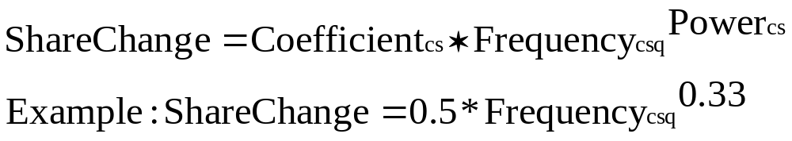
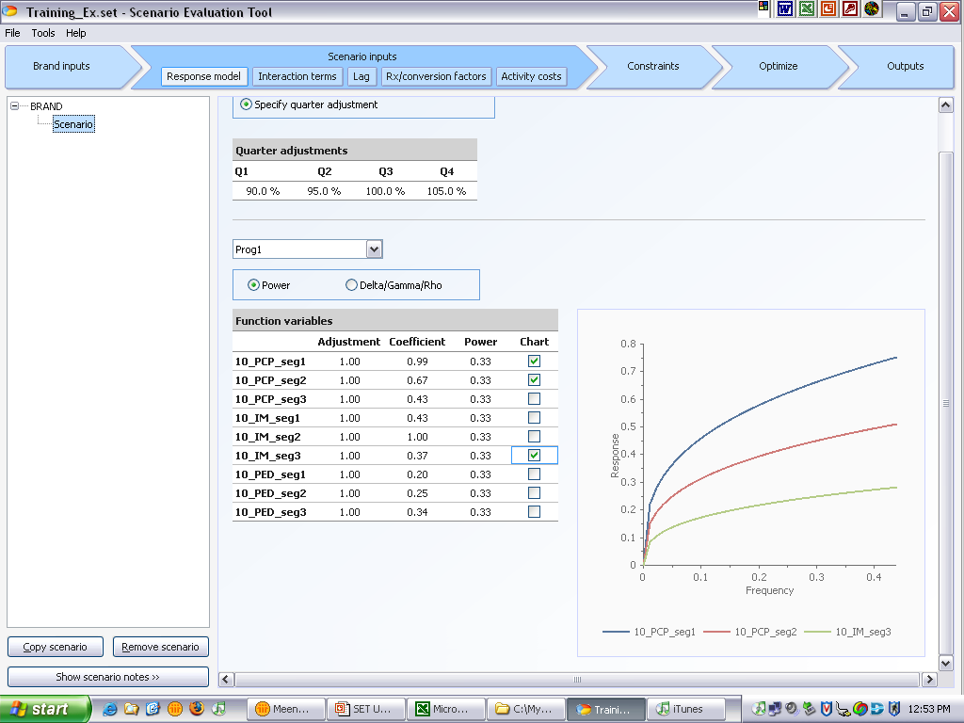
The power function consists of two parameters – a coefficient and a the power - that can be used to model diminishing return curves
Setup
Power Model
Charting functionality allows for comparison of segment response curves

Slide 26
The s-shaped function consists of 3 parameters – delta, gamma, rho; it can be used to generalize different functions including s-shaped curves
Setup
S-shaped curve (also referred to as the Delta-Gamma-Rho Model)
Gamma = concavity parameter, defines shape of the curve
Delta Gamma Rho Response Curve
100
80
60
Delta = Maximum share change
Share Change
40
20
15
5
0
0
5
10
15
20
25
30
35
40
Rho = competition barrier
Frequency

Slide 27
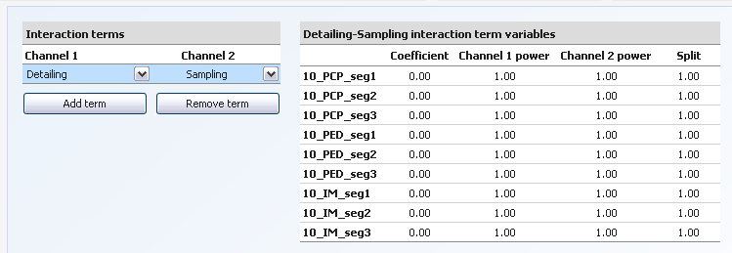
In addition to basic segment/channel response functions, users can also specify channel interactions through the interactions view
Setup
Enter any interaction terms using the dropdown menu to choose both channels and the buttons to add terms
Enter the interaction coefficient term
Enter the first channel’s power term
Enter the second channel’s power term
Enter the spilt as the percentage attributable to the first channel
The interaction term applies to the “minimum of the reach between the two interacting channels”
The impact is modeled as follows:
  Coefficient * (Channel 1 Frequency)^Power1 * (Channel 2 Frequency)^Power2
The interaction revenue is then allocated between the two channels using the split as the percentage attributable to Channel 1

Slide 28
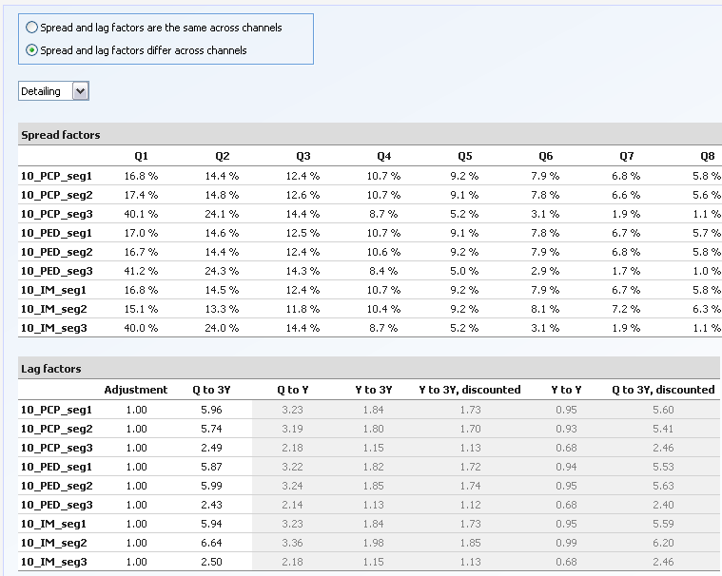
The “Spread factors and lag term” views support entry of parameters to estimate and distribute long-term impact of different channel x segment
Setup
Choose to enter the same spread factors for all channels, or different spread factors for each channel
Use the dropdown menu to move between channels.
Enter spread factors for Q1 through Q12 for each segment
A copy and paste from MS Excel will copy values exactly as displayed. Be careful of rounded values.
Spread factors Q1 through Q 12 must add to 1 for each segment. Be careful of truncated values.
Enter the lag adjustment factor
Enter the Q to 3Y multiplier

Slide 29
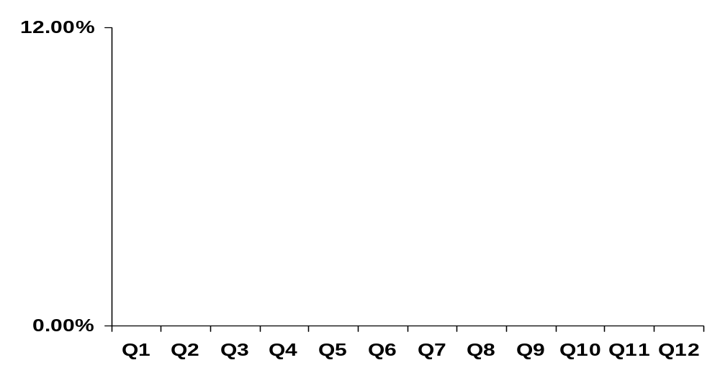
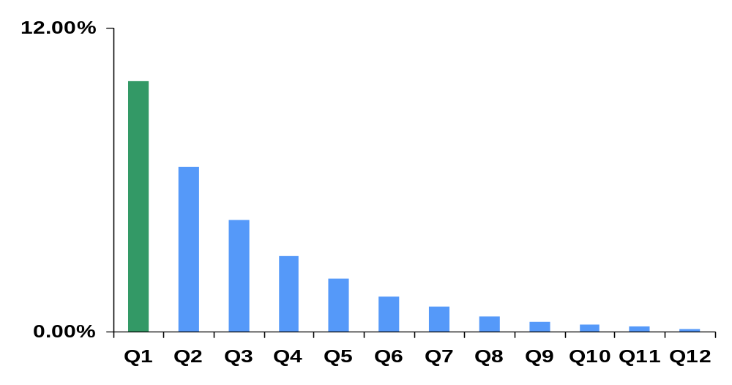
The Q to 3Y lag term estimates 3 year impact of one quarter promotion; Spread factors distribute 3 year impact across underlying quarters
Setup
Shaded area represents 3 year revenue due to promotion in Q1
Optimization decisions are based on the total discounted revenue
Quarterly share
change
x
Q to 3Y
Quarterly
effort
Spread
factors
The spread factors are essentially used to translate 3 year revenue into quarterly revenues for reporting purposes
…

Slide 30
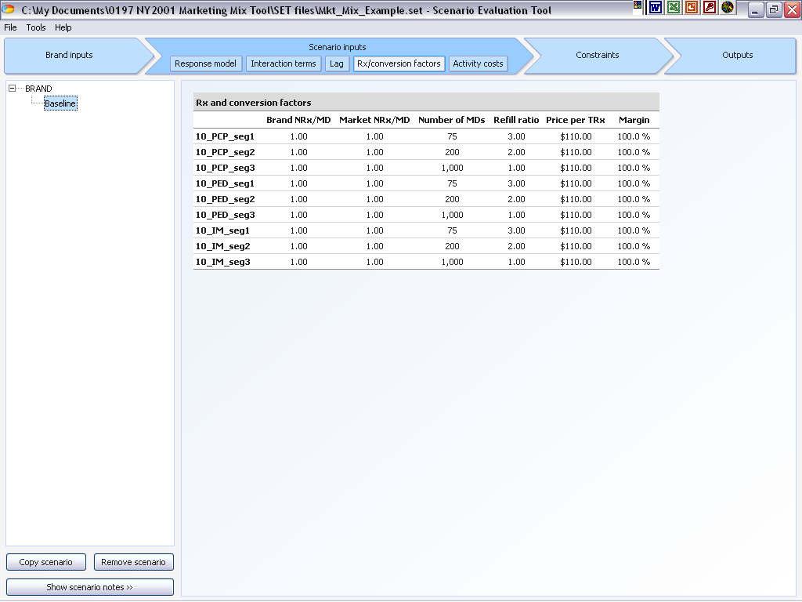
The “Rx and Conversion Factors” view allows the user to enter data necessary to convert response units into NRx/TRx and dollar values
Setup
Enter the historical Brand NRx/MD. This entry serves as a validation point. It is also used in the Year to Year aggregation calculation
Enter the Market NRx/MD, or the number of NRx’s written for each unit response
Enter the number of targeted MD’s in each segment
Enter the refill ratio, or average number of refills per NRx
Enter the price of each filled prescription
Enter the profit margin on each prescription

Slide 31
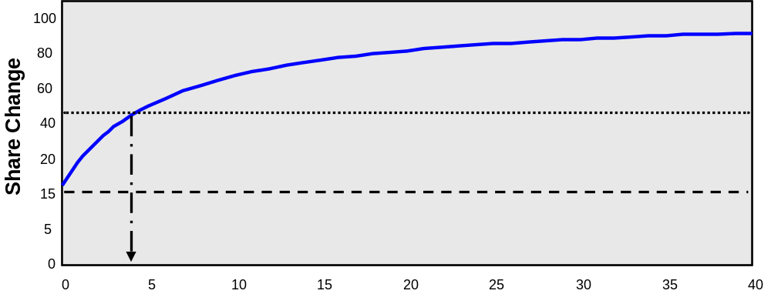
The “Rx and Conversion Factors” view, along with the “Historical Rx per MD” view can be use to create a share model or volume model
Setup
Table | Share Model | Volume Model
Response Model | The Response Model is designed to return a percent share that can be achieved from marketing effort | The Response Model is designed to return a unit value that can be achieved from marketing effort
Market NRx/MD | The total Units of NRx that each segment will generate 10_PCP_seg1 : e.g. 500 NRx | The units of NRx that each response will generate 10_PCP_seg1 : 1 NRx

Slide 32
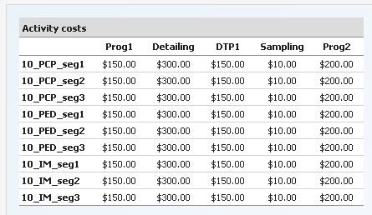
The “Activity costs” view enables the tool to calculate the total cost of effort for spend constraints and contribution calculations
Setup
Enter the activity costs for each marketing channel and segment

Slide 33
Training – Scenario inputs
Setup
Find all necessary inputs in Training_Ex.xls
Specify the Adjustment factor by quarter with
  Q1: 90% Q2: 95% Q3: 100% Q4: 105%
Change the Response curve for the segment that is out of order
Add response curves for the PED segments
Add spread and lag factors for the PED segments
Add Conversion factors and Costs for the PED segments

Slide 34
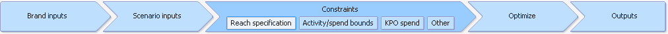
The constraints section of the tool allows users to model different types of constraints on activity and spend metrics
Setup
View Name | Description | Metrics
Reach Specification | Constraints on Reach for each Channel x Segment x Quarter | Reach
Activity/Spend Bounds | Bounding constraints | Activity, Spend, Mix, Frequency
KPO spend | Constraints on spend by Group and ChannelGroup | KPO Spend
Other Constraints | User defined Bounding and Relative constraints | Activity, Spend, Mix, Frequency

Slide 35
The constraints can be specified for activity and spend metrics along many dimensionalities (channel, segment, etc.) and operators (=, <=, >=)
Setup
Illustrations
Reach Constraints: Allow the user to specify Reach by channel & segment
KPO Driven Constraints: Allow the user to understand the effects of the estimated marketing budget
Bounding Constraints: Allow the user to put logical limits on marketing frequency, spend, total activity and the marketing mix
Relative Constraints: Allow the user to limit frequency, activity and spend of categories in relation to each other
BY Channel x Segment: Reach % = Historical Reach or User Specification
BY ChannelGroupxGroup:
Sum (Spend per Quarter)<= Spend Constraint for each ChannelGroupxGroup
Frequency Minimum <= Frequency (Channel) <= Frequency Maximum
Spend (Group 1) <= ½ * Spend (Group 2)

Slide 36
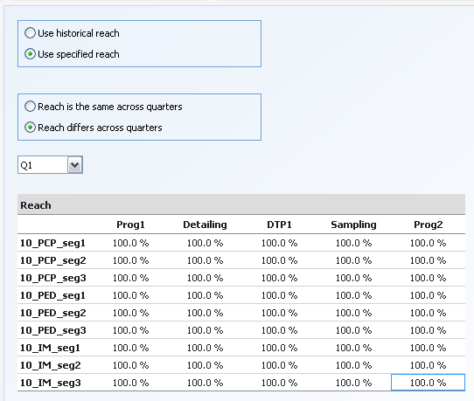
Through the “Reach constraints” view, users can either specify a required reach or assume ability to replicate historically observed values
Setup
Choose to either use historical reach as entered, or specify reach. Choosing to specify reach will unlock the remaining items on the screen
Choose to enter the same reach for all quarters, or different reaches for each quarter
Use the dropdown menu to move between quarters
Enter Reach values for each Channel x Segment in percent

Slide 37
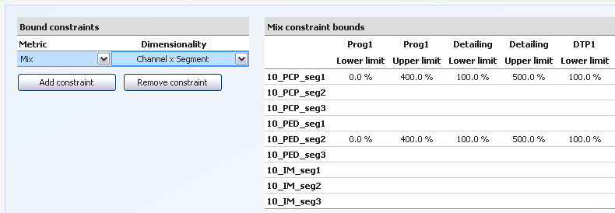
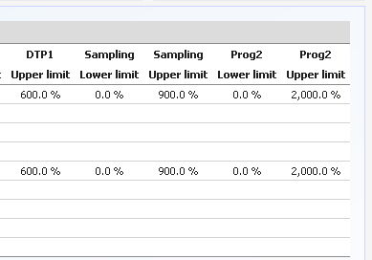
The “Bounding constraints” view enables users to specify lower and upper limits for activity and spend metrics across different dimensionalities
Setup
Enter the lower limit of each constraint as it applies. A blank constraint is not used
Enter any bounding constraints using the dropdown menu to choose metrics and dimensions, and the buttons to add constraints
Enter the upper limit of each constraint as it applies. A blank constraint is not used
Equality constraints can be enforced by setting lower and upper bounds to same value
Bounds on frequency metrics are typically needed for each scenario to reflect access constraints and estimate more realistic activity and financial results

Slide 38
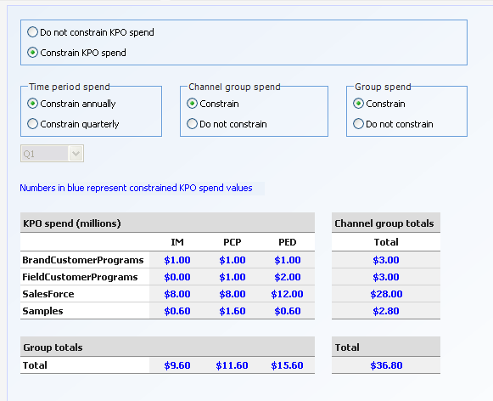
Baseline brand team spend can be simulated by constraining KPO spend across channel group and group dimensions in the “KPO constraints” view
Setup
Choose to either constrain KPO as entered, or ignore this set of spend constraints
Choose to either constrain KPO as annual totals, or quarterly
Choose to either constrain KPO by ChannelGroup or ignore this set of spend constraints
Choose to either constrain KPO by Group or ignore this set of spend constraints
Use the dropdown menu to move between quarters
All chosen KPO constraints are highlighted in blue.
This picture depicts the Baseline Scenario where all KPO constraints are used

Slide 39
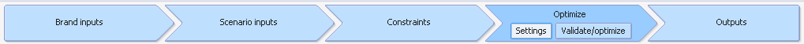
The constraints section of the tool allows users to model different types of constraints on activity and spend metrics
Setup
View Name | Description | Metrics
Validate/Optimize | Options to validate scenarios and optimize scenarios | Listing of all included Brands and scenarios
Settings | Options for optimization settings | Solver method, Initialization settings
The optimize section provides the interface to validate the inputs and invoke the back-end optimization LINGO engine

Slide 40
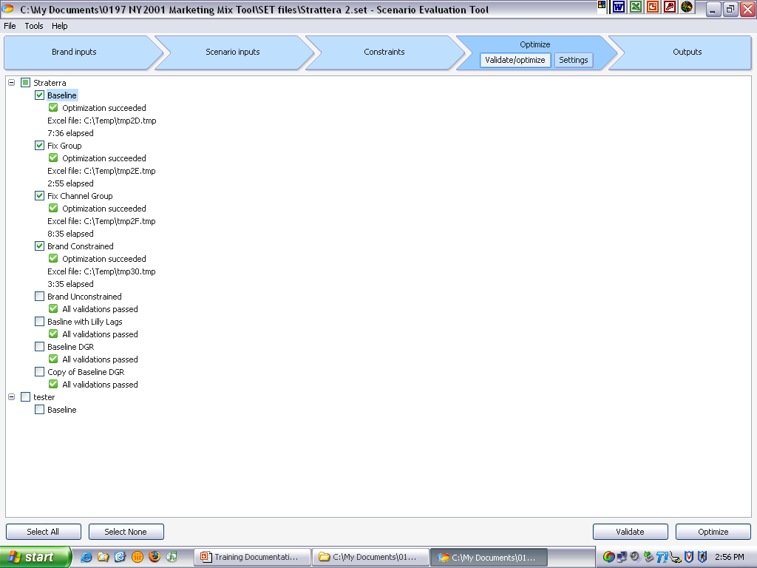
The SET tool supports validation and optimization of a batch of scenarios through the validate/optimize view
Primary scenarios evaluation
Use the checkboxes to select scenarios
OPTIMIZATION NOTES:
1) Ensure that MS Excel is not occupied and able to be accessed
2) Use the Tools → Options menu to choose a location for created files
3) Close unnecessary programs to free processing space
Any validation errors will appear below the scenario in question. Optimization completion and run time are also listed
Use brand level checkbox to select all scenarios within the brand
Use the buttons to either validate or optimize chosen scenarios
Use the buttons to select or deselect all scenarios

Slide 41
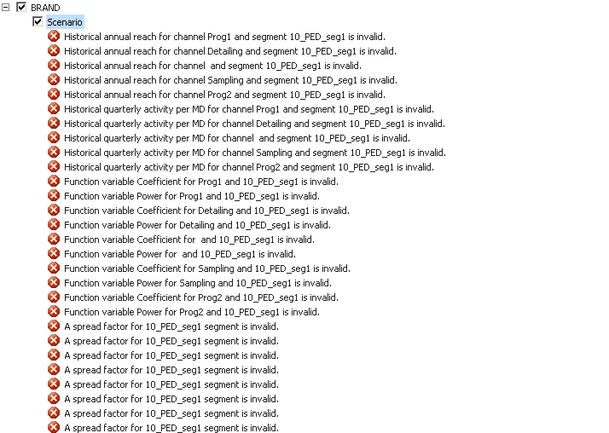


Once all the inputs have been specified users can verify that necessary information has been provided to SET through the validation view
Setup
Validation screen with errors
Validation screen with no errors

Slide 42
The following validation checks are done on different metrics in each view. All errors are reported on the validate/optimize view
Setup
View | Validation Checks
Setup | no duplicates in groups, channels, segments and channel groups
KPO spend | valid numbers: >=0, warning if mix allocation is greater than 100%
Historical Quarterly Activity Per MD | specified, >=0
Historical Annual Reach | specified, >=0
Historical Rx | specified, >=0
Quarter Adjustments | Specified
Response model parameters | specified, >=0
Interactions | no duplicate interactions. All values specified, Coefficients >=0 Split <= 1
Lag | all values specified, non-negative Spread Factors – each <=100% Q to 3Y <= 12
Rx Conversion Factors | all values specified, non-negative Margin <= 1
Activity costs | specified, >=0
Reach | specified, >=0, <=1
Bounding constraints | >=0, lower bound is less than upper bound
The validations are designed for numeric entry checks and cannot perform logical checks (for e.g. magnitude of spend dollars)

Slide 43
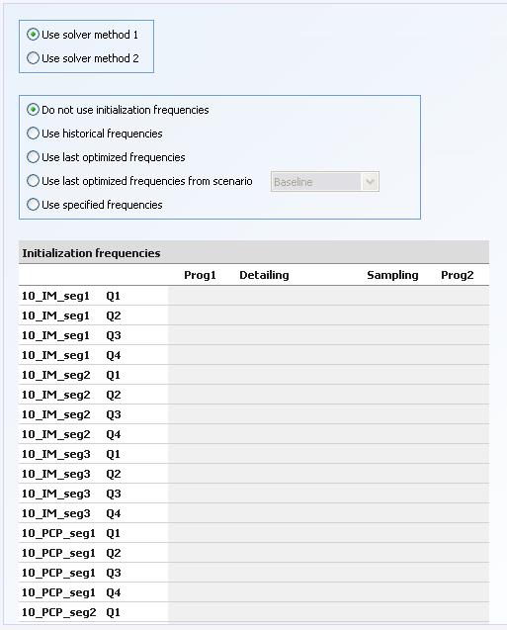
Through the settings window users can select LINGO solver and scenario frequency initialization options
Primary scenarios evaluation
Choose between LINGO solvers. Solver 1 is recommended for use when Solver 2 fails
Choose between various frequency initialization options.
Use the drop down menu to choose a specific scenario from which to pull initialization frequencies
Enter positive numeric frequencies for each. Missing frequencies will be set to 0.
Initializing frequencies will reduce run-time.

Slide 44
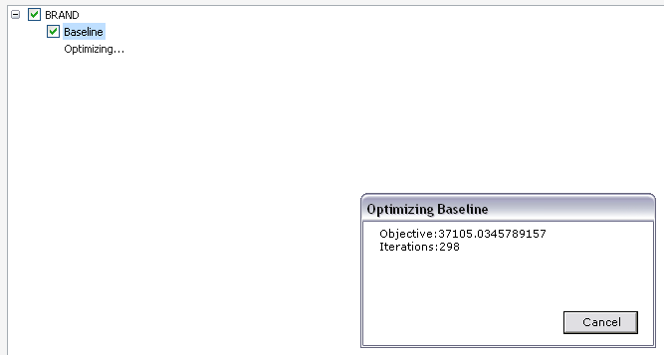
When the optimize button is selected an Excel data file is created and LINGO is invoked; SET provides updates on iterations and objective value
Primary scenarios evaluation

Slide 45
Training exercise – reach/bounding/baseline KPO constraints and validation
Validate the Scenario in Training_Ex.set
Fix any errors and re-run the validation

Slide 46
KPO SPEND BASED SCENARIO EVALUATION PHASE
1. Problem Structure Definition
2. KPO Spend-based Scenarios Evaluation
3. Alternate-Possibility Scenario Evaluation
4. Brand Team Summary Creation

Slide 47
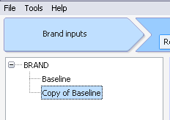
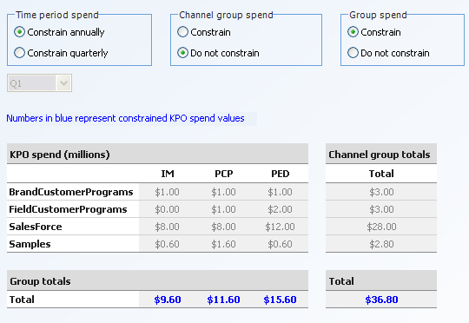
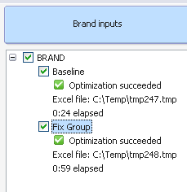
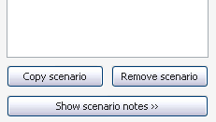
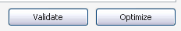
The scenarios derived from the baseline spend can be easily created by copying the baseline scenario, and updating KPO constraint selections
Primary scenarios evaluation
1
2
3
Use the button to create a copy of the Baseline Scenario. Update the name to reflect the KPO constraint type
i.e. Fix Group
Select all desired scenarios and use the buttons to validate/ optimize all scenarios simultaneously
Use the button to turn on/off KPO constraints.
The blue highlighting will automatically reflect the new set of KPO constraints

Slide 48
Training exercise – KPO constraint, batch validation and optimization
Situation: The Brand Team has designed and run the Baseline scenario
Task 1
- Create fixed group, fixed Channel, brand constrained and unconstrained scenarios
- Batch validate the scenarios and optimize the scenarios

Slide 49
The output section of the tool contains all aggregations resulting from the optimization calculation
Primary scenarios evaluation
View Name | Description | Metrics
High Level | Displays key brand incremental revenue and contribution metrics Displays overall brand spend and breakdown by channel groups | 1-year gross and net revenues, 3-year discounted gross and net revenue 1-year costs and marketing mix spend 3-year discounted contributions year 1, 2, 3 gross & net incremental revenue
KPO | Display activity, Rx, spend, and revenue, and contribution metrics by group and channel / channelgroup Also includes graphical output display | Activity: Frequency, reached MDs, activity Rx: 1 and 3 year NRx and TRx Financials: 1- year gross and net revenue 3 year discounted gross and net revenue 1 year costs 1year contribution 3 year discounted contribution year 1,2, 3 gross & net incremental revenue
Detailed | Display of all output metrics by all dimensionalities | same as KPO output screen

Slide 50
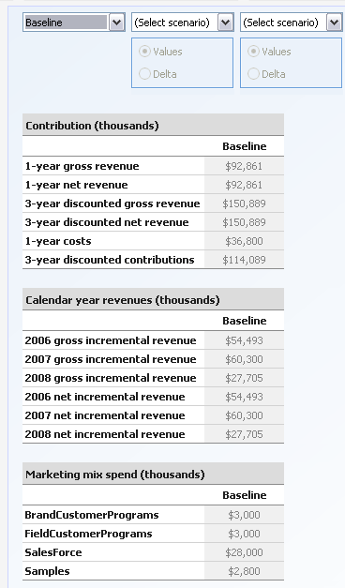
The “high level output” view displays incremental revenue and contribution for the overall brand and spend by channel group
Primary scenarios evaluation
Use the dropdown menu to select the Baseline Scenario
All value outputs are displayed in thousands
1 – year gross revenue:
The total revenue from 1 year following each quarter in the tool
= Qx Revenue * Q to Year Multiplier
where 1≤ x ≤ 4
Calendar Year 1 gross incremental revenue:
The revenue actually earned in the first 4 quarters in the tool
=Q23Y * (Q1*(s1 + s2 + s3 + s4) + Q2*(s1+ s2 + s3) + Q3*(s1 + s2) + Q4*(s1))
where s(x) is a spread factor

Slide 51
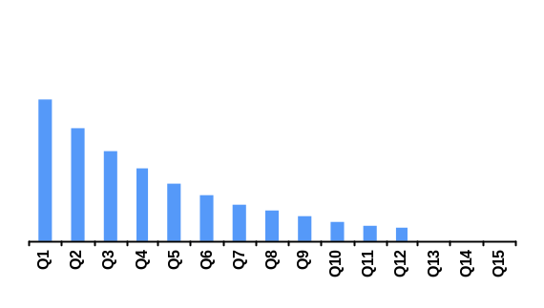
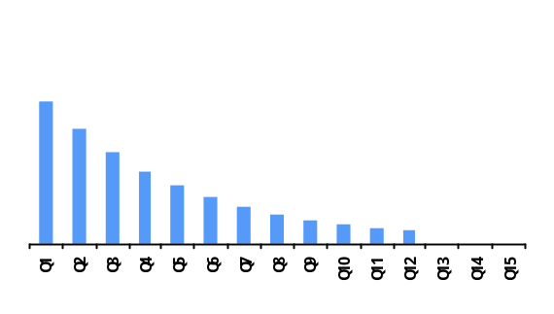
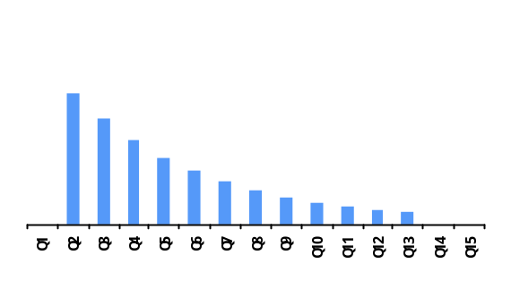
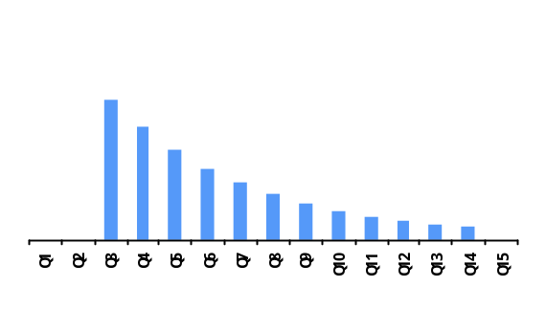
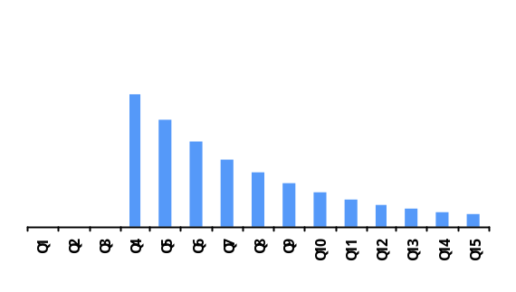
The high level output screen displays incremental revenue and contribution for the overall brand and spend by channel group
Primary scenarios evaluation
1-Year Gross Revenue
Calendar Year 1 Incremental Revenue
Q1 +
Q1 +
Q2 +
Q2 +
Q3 +
Q3 +
Q4
Q4

Slide 52
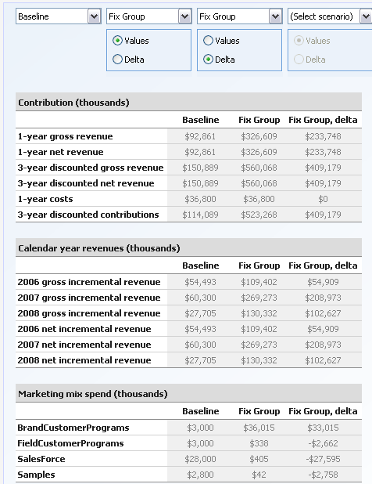
The “high level output” view also supports comparison of up to 5 scenarios. There are options to show absolute values or differentials
Primary scenarios evaluation
Use the buttons to chose output form either values or delta
Deltas are calculated as chosen scenario minus base scenario

Slide 53
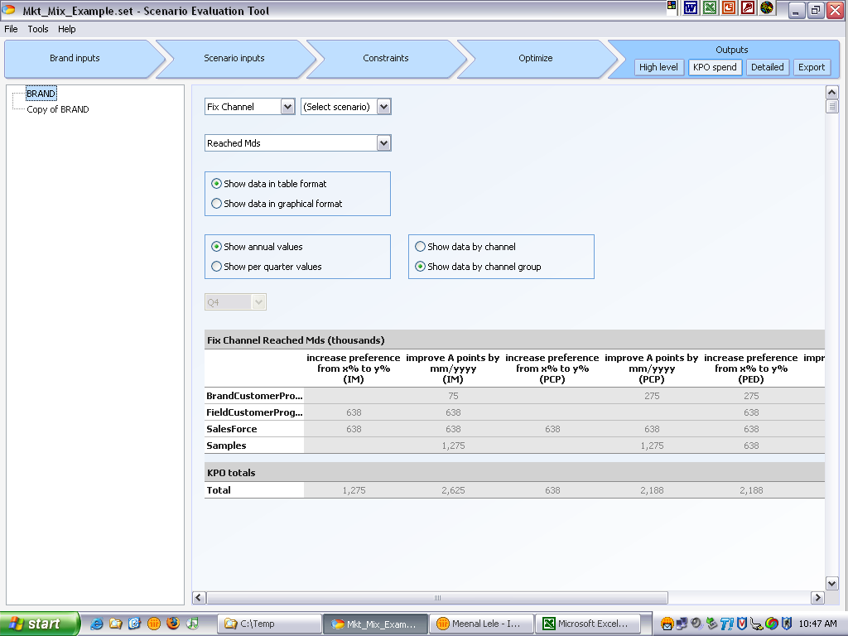
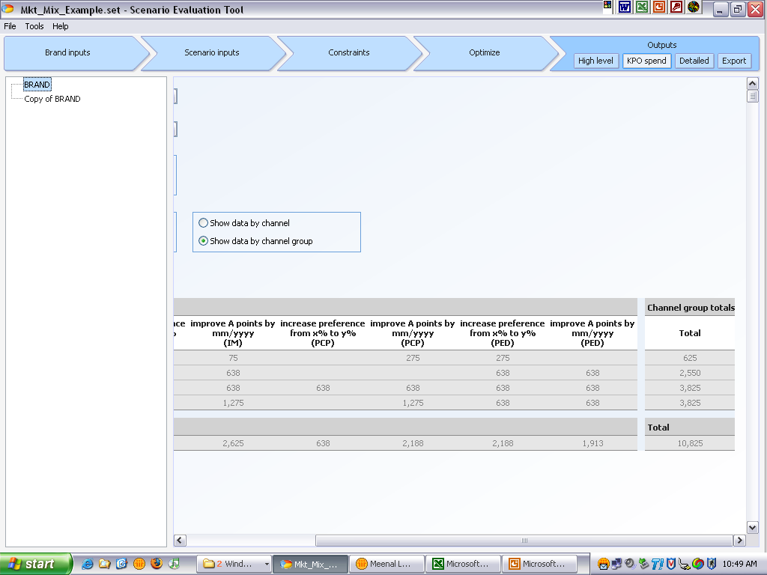
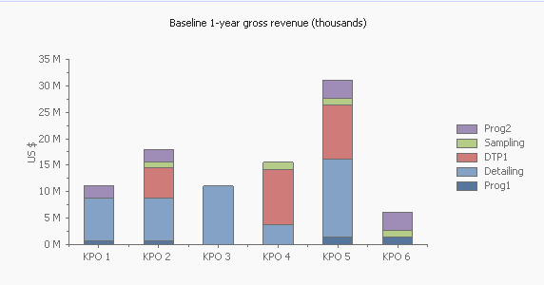
The “KPO outputs” view supports a tabular and graphical view by KPO and channel or channel group for activity, Rx, spend, and revenue metrics
Primary scenarios evaluation
Use the dropdown menu to select the base comparison scenario
Use the dropdown menu to select a metric
Choose to either show data as a table or graph
Choose to either show data by channels or channel groups
Choose to either show annual or quarterly data
Use the dropdown menu to choose a quarter
Graphical output from above table

Slide 54
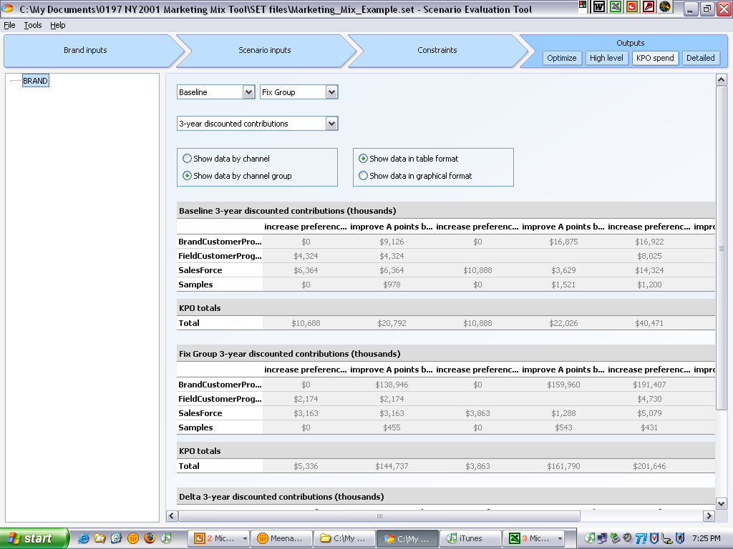
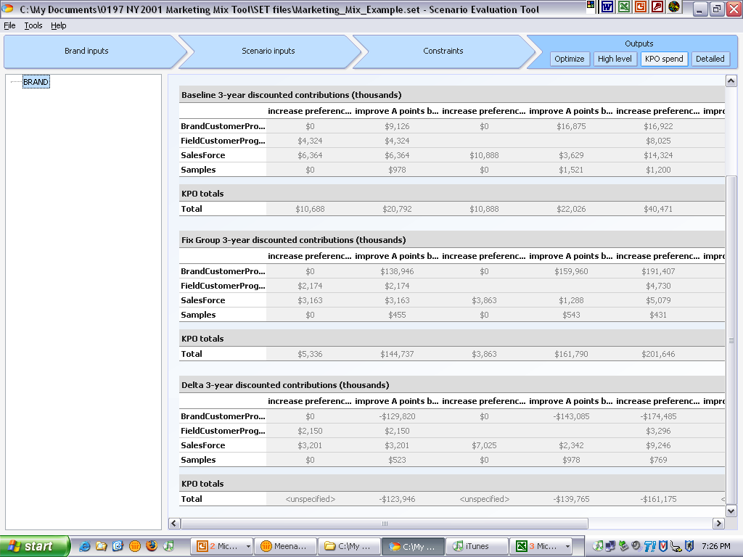
The “KPO outputs” view also supports comparison of up to 2 scenarios at a time of the different metrics
Primary scenarios evaluation
The KPO outputs can be viewed in graphical form
The KPO outputs screen will display:
The base scenario KPO outputs
The chosen scenario KPO outputs
The delta, or base minus chosen, of the KPO outputs

Slide 55
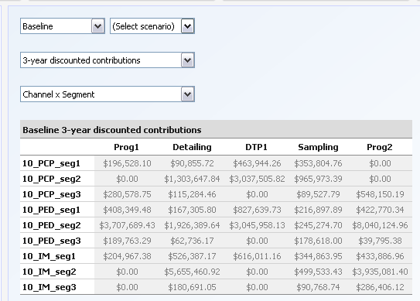
The “detailed output” view supports display of an exhaustive set of metrics and dimensions
Primary scenarios evaluation
Use the dropdown menu to select the base Scenario
Use the dropdown menu to select a metric
Use the drop down menu to choose a the dimensions of the rows and columns

Slide 56
The detailed outputs are available for a large number of metrics and dimensions
Primary scenarios evaluation
Output Metrics
Optimal Frequency
Reached MD’s
Activity
Year to Year Lag
Mix Percentage
1 Year NRx
1 Year TRx
1- year gross revenue
1- year net revenue
1- year costs
1- year contribution
3- Year NRx
3- Year TRx
3 year discounted gross revenue
3 year discounted net revenue
3 year discounted contributions
Year 1gross incremental revenue
Year 2 gross incremental revenue
Year 3 gross incremental revenue
Year 1 net incremental revenue
Year 2 net incremental revenue
Year 3 net incremental revenue
Available Dimensions
Channel x Segment x Quarter
Channel x Group x Quarter
ChannelGroup x Segment x Quarter
ChannelGroup x Group x Quarter
Channel x Segment
Channel x Group
ChannelGroup x Group
Channel x Quarter
ChannelGroup x Quarter
Segment x Quarter
Group x Quarter
Channel
ChannelGroup
Group
Segment
Quarter
Brand

Slide 57
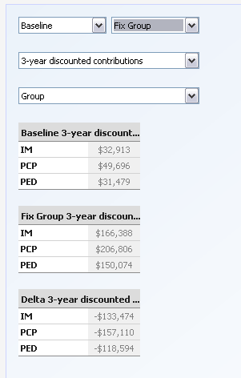
Similar to the other output views the detailed output view also supports comparison of scenarios
Primary scenarios evaluation
The detailed outputs screen will display:
The base scenario KPO outputs
The chosen scenario KPO outputs
The delta, or base minus chosen, of the KPO outputs

Slide 58
Training – key takeaways from output review discussion
Primary scenarios evaluation
Please review the results for the different scenarios and summarize the key takeaways
  - What are the run times?
  - What are the optimization status messages?
  - Create a chart that compares spend distributions and a graph comparing contributions.

Slide 59
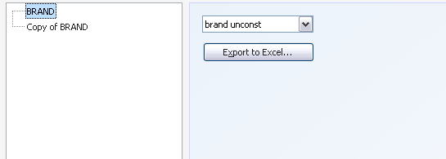

In addition to viewing the results in SET users can also export them to an Excel file from the export view in the outputs section
Primary scenarios evaluation
Use the dropdown menu to select a scenario to export
Use the button to choose a location to which the excel file will be saved
Enter a file name

Slide 60

The Excel export file consists of worksheets organized by dimension and shows all relevant metrics within each dimensionality
Primary scenarios evaluation
Each dimension is shown on a separate worksheet with the metrics displayed as columns for easy manipulation
The dimensions are displayed in rows, creating a unique combination across columns

Slide 61
Agenda
Overview 10:00 to 10:20am
  Marketing planning approach overview
  Scenario evaluation tool (SET) overview
    Role and primary functionality
    Key inputs and outputs
    Software structure
  Project flow
Mock Project1 – Session1 10:20 to 12:00am
  Tool Setup
  KPO Spend based scenario creation
Mock Project1 – Session2 12:00 to 1:00pm
  Alternate Scenarios Evaluation
  Brand Team Meeting Preparation

Slide 62
ALTERNATIVE SCENARIOS EVALUATION PHASE
1. Problem Structure Definition
2. KPO Spend-based Scenarios Evaluation
3. Alternate-Possibility Scenario Evaluation
4. Brand Team Summary Creation

Slide 63
There are several alternative situations that the user may need to analyze which require specification of additive and relative constraints
Alternative scenarios evaluation
Additive:
Total spend across multiple groups
  Example: Sum of spend across Psychs and PCPs <= $100MM
Relative:
Samples per detail constraints
  Example: For each segment, Frequency of samples <= 3*Frequency of details
Relative constraints on Mix by channel
  Example: Percent of spend in channel1 > Percent of spend in channel 2
Relative constraints on Spend by group
  Example: Dollar spend on segment 1 > Dollar spend on segment 2
Relative constraints on Spend across quarters
  Example: For each segment and channel, Spend in Q1 > Spend in Q2
Illustration

Slide 64

Additive constraints support selection of a metric and a bound but with flexibility to select multiple dimensions & multiple elements within
Alternative scenarios evaluation
All added constraints will appear in a list
Use the dropdown menu to choose a metric
Use the dropdown menu to choose an equality. Choose “between” to enter an upper and lower limit.
Enter the bounding limits of each constraint as they apply.
Use the check boxes to choose the dimensions to which the constraint will apply. Use the Select All to choose all elements within a dimension
Use the Total checkbox to apply the constraint as a sum of the chosen elements rather than on each element
Constraints will appear here as written
Add a new bounded/relative constraint using the buttons to open the editor window
Use the buttons to copy a selected bounded constraint or to open the editor window

Slide 65

Additive constraints example
Alternative scenarios evaluation
To write “Annual spend for Sampling + Detailing <= $25MM,” use the bounded constraint editor

Slide 66

Relative constraints allow users to setup relative restrictions on metrics between dimensions and elements within
Alternative scenarios evaluation
Use the dropdown menu to choose a metric
Enter an additive parameter to each constraint as it applies.
Use all check boxes to choose dimensions to which the constraint will apply. Use the Select All to choose all elements within a dimension
Use the dropdown menu to choose an equality.
Enter a multiplicative parameter to each constraint as it applies.
Use the For Each checkbox to apply the constraint to each element rather than
as a sum of the chosen elements
Constraints will appear here as written

Slide 67

Relative constraints example
Alternative scenarios evaluation
To write “Samples per Detail <= 10,” use the relative constraint editor

Slide 68


The mix constraint, which allows users to specifically allocate spend across a dimension, can be created using the Activity/Spend Bound or the Other Constrains screen
Alternative scenarios evaluation
Setting upper and lower limits equal forces mix to allocate exactly as defined.
OR
Other Constraints: Relative Constraints
When using mix constraints it is important to check for conflicting constraints

Slide 69
Training exercise – alternative scenarios
Alternative scenarios evaluation
Additive constraint: Copy baseline scenario and enter a constraint that limits the total number of speaker programs over the year to 100
Relative constraint: Copy baseline scenario and enter a constraint limiting sample frequency for each segment to no more than 10 times details
Optimize alternative scenarios and ensure constraints are satisfied; Compare activity and financial revenue impact of each dynamic constraints

Slide 70



Additional brands and scenarios can be imported by selecting the import button and browsing and selecting scenarios in other SET files
Alternative scenarios evaluation
From the Brand Input screens, use the Import button to open the Import screen
Use the Browse button to select a file. Use the checkboxes to select any scenarios and brands. Use the Import button to finish.
All imported scenarios and associated brands will appear on scenario/brand list.
To successfully import a scenario into an existing brand its groups, segments, channels, channel groups, and KPOs should be identical.

Slide 71
BRAND TEAM MEETING PREPARATION
1. Problem Structure Definition
2. KPO Spend-based Scenarios Evaluation
3. Alternate-Possibility Scenario Evaluation
4. Brand Team Summary Creation

Slide 72
Outlined below is a possible structure for the brand team meeting session presentation
Brand team meeting preparation
Executive summary
Baseline brand team results summary and insights
  Baseline brand team spend input by channel x KPO
  High level revenue and spend outputs
  High level KPO outputs
  Detailed frequency outputs
Baseline brand team inputs and constraints summary
  Response summary
  Lag summary
  Costs, price, margin summary
  Key constraints - frequency bounds, samples per detail, etc.
KPO scenario results comparison and insights
  High level revenue and spend comparisons
  Detailed frequency comparisons
Interactive session with tool
Next steps

Slide 73
At the brand team meeting, additional scenarios can be created based on brand team inputs and results reviewed to understand the impact
Brand team meeting
Quarterly budget constraints
  Example: “We anticipate that we will have a greater percent of our promotional budget available in the first half of the year and would like to use it effectively upfront”
Impact adjustment for different channels
  Example: “The responsiveness of physicians to sampling will decrease and to detailing will increase as we progress along the brand’s lifecycle”
  Example: “The responsiveness of PCPs to promotion increases in Fall because patients wait to put their children back on stimulants medication more so than competitors”
Implementation adjustment for different channels
  Example: “We expect to improve speaker program reach for Byetta over historical levels as there is increasing awareness in the PCP community of novel diabetic therapies and an interest to learn more about their mechanisms and success rates”

Slide 74
Training - Brand team meeting session
Brand team meeting
Situation: The team has created an optimal mix based on historical response estimates. Brand team believes that physician responsiveness and the long term effect of marketing effort need to be adjusted
The historical data is contained within CaseTwo.set.
Adjust the response model using the graphs on the Response Screen as guides:
- Reduce the impact of Prog 2, and increase the impact of Prog 3.
Adjust the lag terms using the accompanying Training_LagCalculation.xls
- IM and PSY have higher Lag than PCP’s. IM is estimated closer to 70%, PSY is roughly 75% and PCP is roughly 50%

Slide 75
Appendix

Slide 76



Explanation of lag terms
Setup
The Lag Term is the sales value in Qi as a fraction of Q1 that can be attributed to Q1
The Carryover is herein referred to as the Lag from one quarter to the next.
The Q to 3Y multiplier is the sum of all sales from Q1 through Q12 attributable to effort in Q1
The Q to Y multiplier is the sum of all sales from Q1 through Q4 attributable to effort in Q1
The Spread Factor in Qi is the percent of total sales from Q1 through Q12 attributable to effort in Q1 but occurring in Qi.

Slide 77
Running a scenario optimization utilizes the LINGO optimization structure and code
Primary sets
Derived sets
Data from Tool
Frequency initialization
SETS:
CHA: BRND, alphamodel_switch, gammamodel_switch;
SEG: MDCOUNT, MARGIN, PRICE, MKTNRX, REFILLRAT, GRP;
QTR: QADJ, QNRXADJ;
GROUP: GRPNAME;
BRANDCHA: BRANDNAME;
INTERACT: CHANNEL1, CHANNEL2;
CHAxSEG (CHA,SEG):ACTCOST,Impact_Adj, Lag_Adj, Q2YLAG, Y23Ydisc, FRC_ALPHA,
FRC_BETA, FRC_DELTA, FRC_GAMMA, FRC_RHO;
CHAxSEGxQTR(CHA,SEG,QTR): REACH, FREQ;
INTERACTxSEG(INTERACT,SEG):SPLIT, INTER_ALPHA, INTER_BETA, INTER_BETA2;
INTERACTxSEGxQTR(INTERACT,SEG, QTR): MIN_REACH;
!Switches (ON: 1 | OFF: 0)
interact_switch;
ENDSETS
DATA:
ACTCOST, BRANDCHA, BRANDNAME, BRND, CHA, CHANNEL1, CHANNEL2, FRC_ALPHA, FRC_BETA, FRC_DELTA, FRC_GAMMA, FRC_RHO, GROUP, GRP, GRPNAME, Impact_Adj, INTER_ALPHA, INTER_BETA, INTER_BETA2, INTERACT, Lag_Adj, MARGIN, MDCOUNT, MIN_REACH, MKTNRX, PRICE, Q2YLag, QADJ, QNRXADJ, QTR, REACH, REFILLRAT, SEG, SPLIT, Y23Ydisc, alphamodel_switch, gammamodel_switch, interact_switch= @OLE('C:\Temp\tmp20A.tmp');
ENDDATA
INIT:
FREQ = @OLE('C:\Temp\tmp20A.tmp');
ENDINIT

Slide 78
Running a scenario optimization utilizes the LINGO optimization structure and code (cont.)
Objective Function
Revenue using power model
Revenue using DGR model
Revenue from Interaction: Channel 1
Revenue from Interaction: Channel 2
Costs
Constraints
!Objective Function;
[rObj] MAX =
@SUM(CHAxSEGxQTR (C,S,Q):MARGIN(S) * PRICE(S) *alphamodel_switch(C) *QADJ(Q)*MDCOUNT(S)* MKTNRX(S)* QNRXADJ(Q)* REFILLRAT(S)* Q2YLAG(C,S)* Y23Ydisc(C,S)* Lag_Adj(C,S)* Impact_Adj(C,S)*REACH(C,S,Q)* FRC_ALPHA (C,S)* FREQ(C,S,Q)^FRC_BETA(C,S))
+ @SUM(CHAxSEGxQTR (C,S,Q): MARGIN(S) *PRICE(S) *gammamodel_switch(C) * QADJ(Q)* MDCOUNT(S)* MKTNRX(S)* QNRXADJ(Q)* REFILLRAT(S)* Q2YLAG(C,S)* Y23Ydisc(C,S)* Lag_Adj(C,S)* Impact_Adj(C,S)* REACH(C,S,Q)*(( FRC_DELTA(C,S)* FREQ(C,S,Q)^FRC_GAMMA(C,S))/(FREQ(C,S,Q)^FRC_GAMMA(C,S)+ FRC_RHO(C,S)^FRC_GAMMA(C,S))))
+ @SUM(INTERACTxSEGxQTR(I,S,Q):MARGIN(S) *PRICE(S) * SPLIT(I, S)* QADJ(Q)* MDCOUNT(S)* MKTNRX(S)* QNRXADJ(Q)* REFILLRAT(S)* MIN_REACH(I,S,Q)* INTER_ALPHA(I,S)* @sum(CHA(C)| C #EQ# CHANNEL2(I): FREQ(C,S,Q)^INTER_BETA2(I,S)) * @sum(CHA(C)| C #EQ# CHANNEL1(I): Q2YLAG(C,S)*Y23Ydisc(C,S)* Lag_Adj(C,S)* Impact_Adj(C,S) *FREQ(C,S,Q)^INTER_BETA(I,S)))
+ @SUM(INTERACTxSEGxQTR(I,S,Q):MARGIN(S)* PRICE(S) * (1-SPLIT(I, S))* QADJ(Q)* MDCOUNT(S)* MKTNRX(S)* QNRXADJ(Q)* REFILLRAT(S)* MIN_REACH(I, S, Q)* INTER_ALPHA(I,S)*@sum(CHA(C)| C #EQ# CHANNEL1(I): FREQ(C,S,Q)^INTER_BETA(I,S)* Q2YLAG(C,S)*Y23Ydisc(C,S)* Lag_Adj(C,S)* Impact_Adj(C,S)) *@sum(CHA(C)| C #EQ# CHANNEL2(I): FREQ(C,S,Q)^INTER_BETA2(I,S)))
- @SUM(CHAxSEGxQTR (C,S,Q): MDCOUNT(S)* FREQ(C,S,Q)* REACH(C,S,Q)*
ACTCOST(C,S));
!Constraints Section;
@FOR (CHAxSEGxQTR(C,S,Q): FREQ(C,S,Q) >= 0); …

Slide 79
Run-times for scenarios increase exponentially with increasing numbers of variables
Scenario optimization
Scenario 1 :
756 variables = Channels (7) * Segments (27) * Quarters (4)
Scenario 2 :
180 variables = Channels (5) * Segments (9) * Quarters (4)
Scenario | Scenario 1 | Scenario 2
Baseline | 305 sec | 26 sec
Group Constrained | 240 sec | 13 sec
Channel Group Constrained | 240 sec | 10 sec
Brand Constrained | 210 sec | 30 sec
Brand Unconstrained | 100 sec | 16 sec

Slide 80



“The brand’s baseline $xxMM spend distribution across yy key player objectives and zz channel groups formed the basis of the analysis”
Brand team meeting preparation
Illustration

Slide 81

“Analysis suggests an incremental 3 year discounted contribution of $xxMM based on this marketing spend plan”
Brand team meeting preparation
Illustration

Slide 82
“Comparing alternative allocations of marketing spend suggests that optimizing allocation by channel group presents an opportunity”
Brand team meeting preparation
Revenue, cost, and contribution Metrics ($MM) |  | Baseline | Channel group constrained | Group constrained | Brand constrained
1 year | Gross revenue | $258 | $264 | $316 | $316
 | Net revenue | $258 | $264 | $316 | $316
 | Costs | $175 | $175 | $175 | $175
3 year | Gross revenue | $370 | $379 | $453 | $453
 | Net revenue | $370 | $379 | $453 | $453
 | Discounted contribution | $195 | $205 | $279 | $279
Illustration

Slide 83
“The initial analysis suggested shifting mix to increase spend on samples and field customer programs”
Brand team meeting preparation
Channel mix distribution | Baseline $ MM/ % |  | Channel group constrained $MM / % |  | Group constrained $MM/ % |  | Brand constrained $MM/ %
Audio | $4 | 2% | $4 | 3% | $11 | 6% | $11 | 6%
Detail | $140 | 80% | $140 | 80% | $61 | 35% | $59 | 34%
DTP1 | $6 | 3% | $6 | 3% | $32 | 18% | $35 | 20%
DTP2 | $2 | 1% | $2 | 1% | $3 | 2% | $3 | 2%
Mail | $1 | 0% | $1 | 0% | $0 | 0% | $0 | 0%
Samples | $14 | 8% | $14 | 8% | $46 | 26% | $45 | 26%
Speaker | $8 | 5% | $8 | 4% | $22 | 13% | $22 | 12%
Illustration

Slide 84
“Incorporating samples per detail constraints and bounding constraints on DTP program reach suggests …”
Brand team meeting preparation
Illustration
Channel mix distribution | Baseline $ MM/ % |  | Channel group constrained $MM / % |  | Group constrained $MM/ % |  | Brand constrained $MM/ %
Audio | $4 | 2% | $4 | 3% | $11 | 6% | $11 | 6%
Detail | $140 | 80% | $140 | 80% | $61 | 35% | $59 | 34%
DTP1 | $6 | 3% | $6 | 3% | $15 | 18% | $15 | 20%
DTP2 | $2 | 1% | $2 | 1% | $3 | 2% | $3 | 2%
Mail | $1 | 0% | $1 | 0% | $0 | 0% | $0 | 0%
Samples | $14 | 8% | $14 | 8% | $20 | 26% | $20 | 26%
Speaker | $8 | 5% | $8 | 4% | $22 | 13% | $22 | 12%
Illustration
Analysis suggests that Sampling should be increased, however returns are diminished with logistic constraints

